Slide 1

ePro Online Receiving Enhancements
Focus Group Meeting
June 3, 2015

Slide 2
Today’s Agenda
Introductions - Expectations
Project Overview
  Scope
  Project Phases
Current Electronic Receiving
  What works well?
  What changes would be helpful?
Color Schemes
Questions/Next Steps

Slide 3
Project Teams
Project Lead | Debby Zumbach
  John Watkins
  Denise Hyche
  Karen Housel
  Dani Weber
  Chris Leichty
  Julie Bergeon
IT Programmers
  Jason Heath
  Ben O'Brien
  David Miller
Focus Group
  Doug Eltoft
  Bob Krogmeier
  Kirby Luckett
  Ruth Medd
  Kris Miller
  Jennifer Partida
  Julie Roberts
  Cindy Rohret
  Lela Schumacher
  Kevin Singleman
  Rhonda Wetjen
  Michele Worrell

Slide 4
Scope of Work
More Modern Look
Enhanced User Security
Improved Functionality
Better Accessibility - Mobile Friendly
Emails issued 2-3 days after voucher created to match with invoice image availability
New Worklist
User Friendly
Easy Navigation

Slide 5
ePro Timeline
Receiving Modifications
Project completion late 2015
PReq Modifications
eVoucher Modifications
Integrate with new workflow
Integrate with new workflow

Slide 6
Receiving Project High Level Timeline
June
Kick off
Detailed Design
July-August
Infrastructure Building
September
Testing
Review
October-November
Finalize
Go-Live
Training

Slide 7
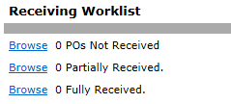
Current Receiving Process
Worklist
Receiving Page

Slide 8


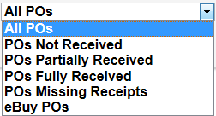
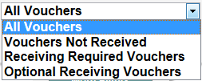

Feedback
What works well?
What changes would be helpful?

Slide 9





Color Schemes
Screen resolutions vary, so survey will be sent to select favorite.
Add any feedback at the end of the survey.
Notes:
Change to

Slide 10
Next Steps
Next Meeting in July
Feedback and Color Scheme choice
Receiving Mock-up Demo
www.uiowa.edu/ap-purchasing/receiving-2.0

