Slide 1

ePro Online Receiving Enhancements
Focus Group Meeting
November 11, 2015

Slide 2
Today’s Agenda
Receiving Enhancements
Receiving Demo
Timeline
Questions/Next Steps

Slide 3
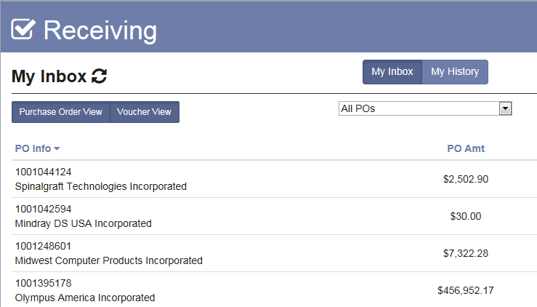
Receiving Enhancements
Online receiving functionality rewritten with usability and functionality improvements
New Receiving Worklist
Improved overall navigation
Display Vouchers and POs which need receipts
New sort options by priority and all vouchers in a particular department
Eliminate closed orders and orders with negative lines in worklist

Slide 4
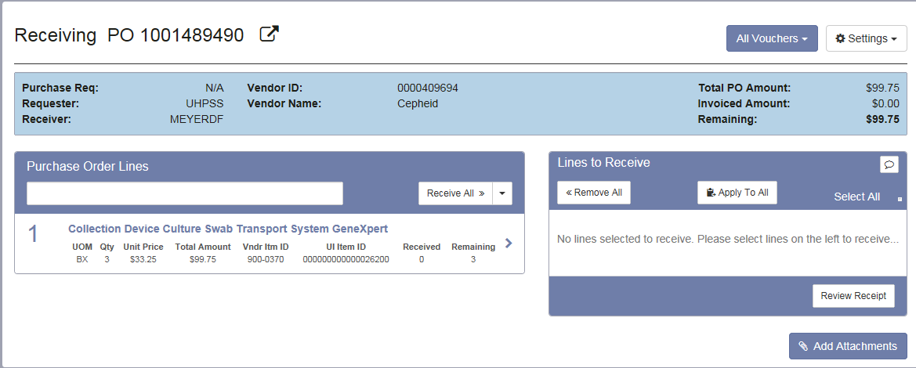
Receiving Enhancements
Receiving Pages Updated
More organized mobile-friendly look and feel
Ability to apply receipt date, packing slip and capital asset information to all lines
Ability to receive all lines
Ability to edit and cancel receipts
Automated notification for match exceptions

Slide 5
Receiving
Demo

Slide 6
Tentative ePro Receiving Project Timeline
June
Kickoff
Detailed Design
July-August
IT Programming
September
IT Programming
Review
October-November
Testing
Training
December +
Go-Live
Complete Testing/Training

Slide 7

Questions/Next Steps
Testing
Next Meeting
www.uiowa.edu/ap-purchasing/receiving-2.0

